Slide 1

Web Development and Database Project
Travel Booking System
Horizon Travels – Marcus Lee (24017967)

Slide 2
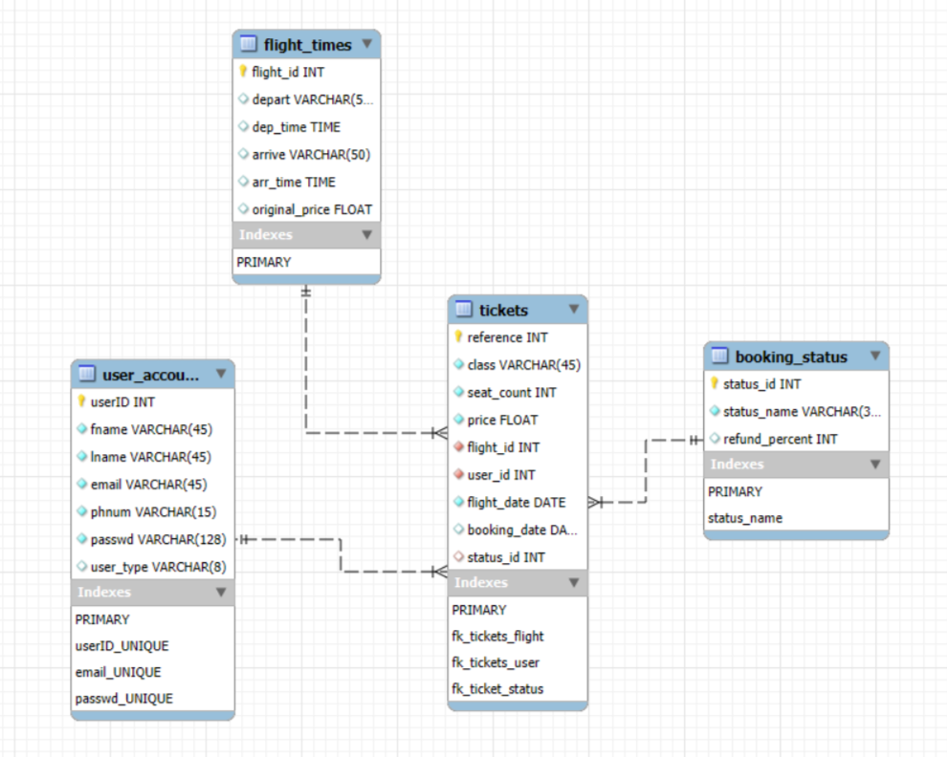
Database Design
First Normal Form (1NF)
Every table has a primary key.
All fields contain atomic values.
Second Normal Form (2NF)
Every table is 1NF.
All non-key attributes are functionally dependent on the primary key.
Third Normal Form (3NF)
Every table is 2NF.
No non-key attributes are transitively dependent on the primary key.

Slide 3
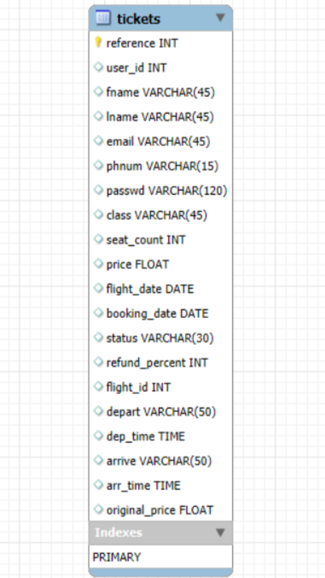
Normalisation Process
Unnormalised Form (UNF) to First Normal Form (1NF)
I started my database with one big table including all travel details including names, destinations, booking date, etc.
The table is already in 1NF since it has a primary key (reference) and all columns and items have atomic values.
But it has partial dependencies, which means some attributes such as user (or passenger) name, and contact details are functionally dependent on user ID which is non-key attribute in this case.
To achieve 2NF from 1NF, partial dependencies need to be removed by splitting the table for users and flight times.

Slide 4
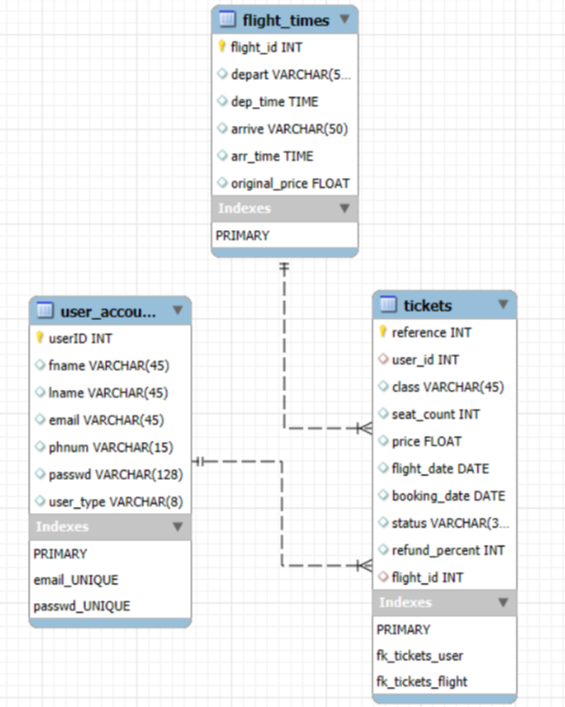
Normalisation Process (Cont’d)
Second Normal Form (2NF)
Partial dependencies are eliminated by separating the user and flight times table.
Each table has a primary key, and all non-key attributes on each table are fully dependent on a single primary key.

Slide 5
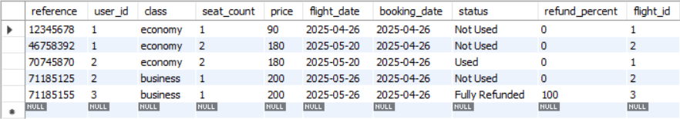
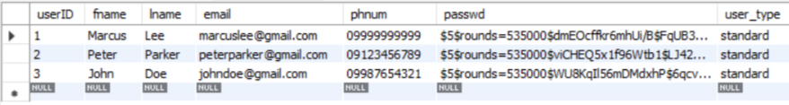
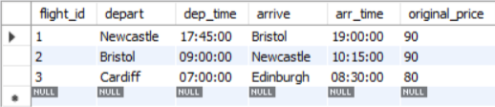
Normalisation Process (Cont’d)
tickets
user_accounts
Second Normal Form (2NF) with data samples
The database is in 2NF and to achieve 3NF, transitive dependencies need to be checked.
In this design, there is a transitive dependency on tickets table since refund percentage is dependent on status of the ticket, which indicates whether the ticket is used/unused, cancelled, or refunded.
Since status is dependent on primary key ‘reference’ and ‘refund_percent’ is dependent on ‘status’, there is an implication of transitive dependency between ‘reference’ and ‘refund_percent’.
flight_times

Slide 6
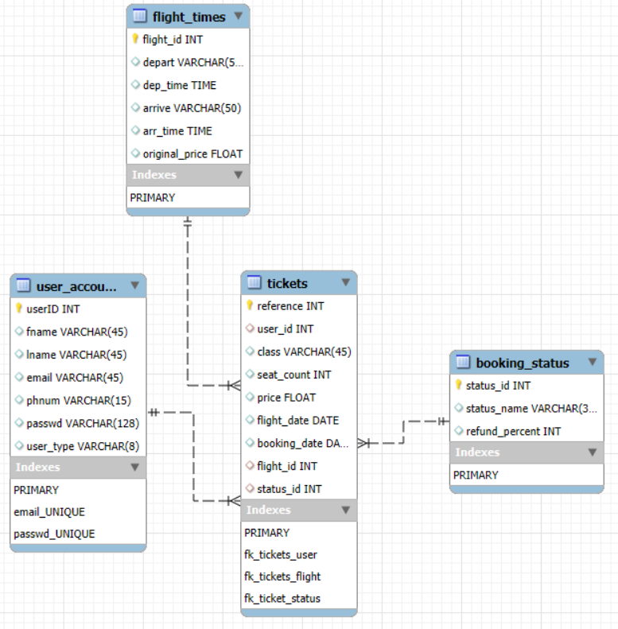
Normalisation Process (Cont’d)
Third Normal Form (3NF)
To eliminate transitive dependency, the ‘status’ attribute is separated into a table ‘booking_status’.
By following this approach, it ensures every non-key attribute fully depends on the primary key, reducing data redundancy and improving data integrity.

Slide 7
LESP
Any images used in this project are stock images. All external links used in this project are free to use for non-commercial and commercial use ( font awesome, Google fonts).
Passwords are stored in hashed form using passlib library from Python, ensuring user data is securely protected.
The code is protected from SQL injections by using parameterised queries.
During registering, the user is informed about data collection and asked for consent to process their data, aligning with GDPR laws.
Ensured my website is accessible in three different screen sizes, allowing diversity and easy access to users to use the website on a variety of devices such as computers, tablets, and mobiles.
User interface is simple and understandable. Only light-weight contents such small sized pictures and CSS are mainly used for styling to minimise the environmental cost of hosting my website.
I believe my website meets all the functional requirements from the assessment brief and includes non-functional requirements like SQL injection prevention and password hashing.
I have tested the full website multiple times to ensure proper functionality on both the front-end and back-end.

Slide 8
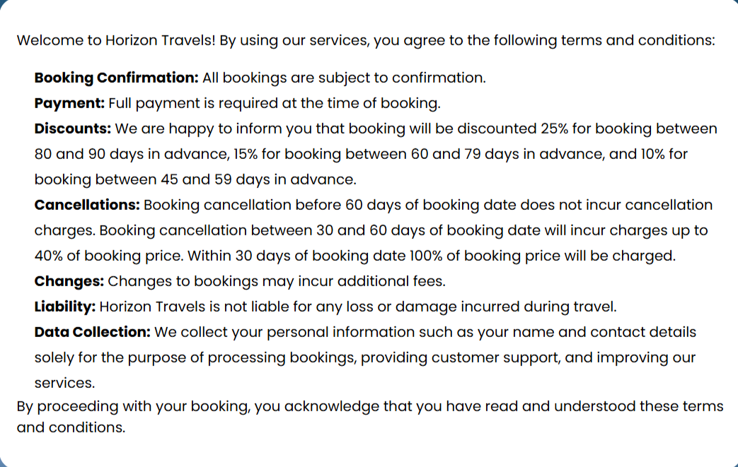
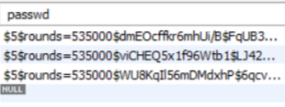
LESP Examples
Terms and Conditions page
Passwords are hashed to provide data security
Parameterised SQL queries to prevent SQL injection

Slide 9
Testing
After implementing all the business logic specified in the assessment brief, I employed white box testing to ensure everything works as required.
This method allowed me to test the internal paths, conditions, loops, and data flow within the code, ensuring comprehensive coverage of the implemented logic.
While the booking process is fully functional, it can be further improved by implementing payment information processing. However, I decided not to include this feature since it is not a requirement of the assessment.
White box testing details and examples are provided in the following slides.

Slide 10
White Box Testing
#Test | Subject | Description | Input | Expected Outcome | Actual Outcome
1 | Forms | Form handling for blank data on required fields | N/A | A prompt to enter the missing field(s) | Prompt pops up as expected
2 | Registration Form | Form handling for incorrect values | Entering numbers on usernames | A red error text is shown to the user | Error pops up as expected
3 | Registration Form | Form handling for registering with an existing email in the system | Entering an existing email to sign up | A red error text ‘Email is already registered’ is shown to the user | Error pops up as expected

Slide 11
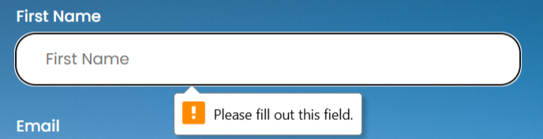
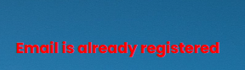
White Box Testing Examples
1
2
3

Slide 12
White Box Testing (Cont’d)
#Test | Subject | Description | Input | Expected Outcome | Actual Outcome
4 | Registration Form and Change Password form | Form handling for unmatched passwords in the two password input boxes | Entering two different passwords in the two password input boxes | A red error text ‘Passwords do not match’ is displayed to the user | Error pops up as expected
5 | Login Form | Form handling for incorrect password | Entering incorrect password for login | A corresponding red error text is displayed to the user | Error pops up as expected
6 | Login Form | Form handling for using email that does not exist in the database | Entering an email that does not exist in login page | A corresponding red error text is displayed to the user | Error pops up as expected

Slide 13
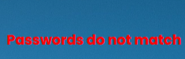

White Box Testing Examples (Cont’d)
4
5
6

Slide 14
White Box Testing ( Cont’d)
#Test | Subject | Description | Input | Expected Outcome | Actual Outcome
7 | Flight date selection during booking process | Form handling for weekend bookings | Entering a weekend date for booking | A red error text is displayed to notify the user that flights operate on weekdays only | Returns the same page and error pops up as expected
8 | Flight date selection during booking process | Form handling for booking on the dates where seats are full | Entering a date where the flight for the chosen class is fully booked | A red error text is displayed to notify the user that the flight is fully booked on the selected date | Returns the same page and error pops up as expected

Slide 15
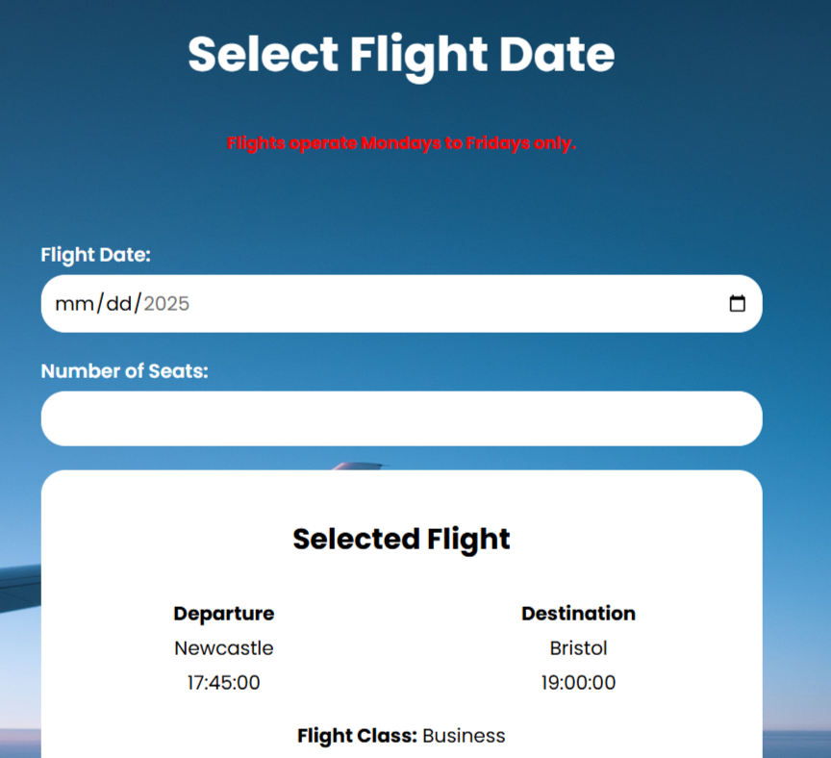
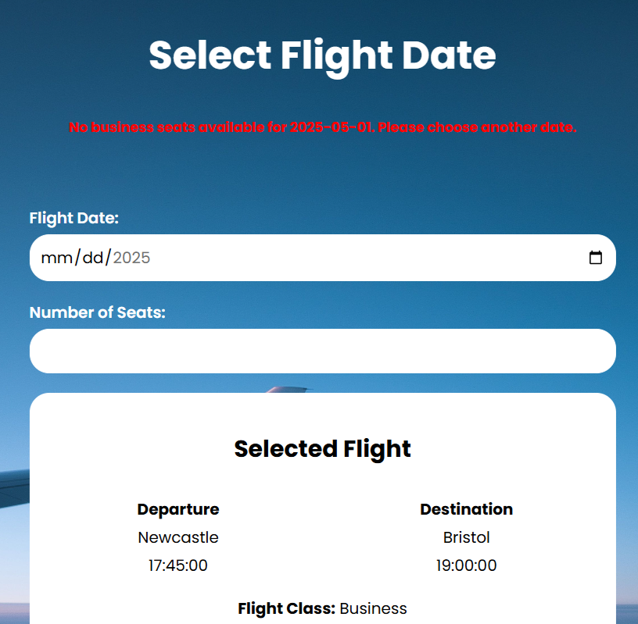
White Box Testing Examples (Cont’d)
7
8

Slide 16
White Box Testing (Cont’d)
#Test | Subject | Description | Input | Expected Outcome | Actual Outcome
9 | Flight date selection during booking process | Form handling for booking more seats than available | Entering more seats for the chosen class than availability | A red error text is displayed to notify the user that only a certain number of seats are available for the selected date | Returns the same page and error pops up as expected
10 | Change Password Form | Form handling for entering the same old password as a new one | Entering the same old password as a new one | A corresponding red error text is displayed to the user | Error pops up as expected

Slide 17
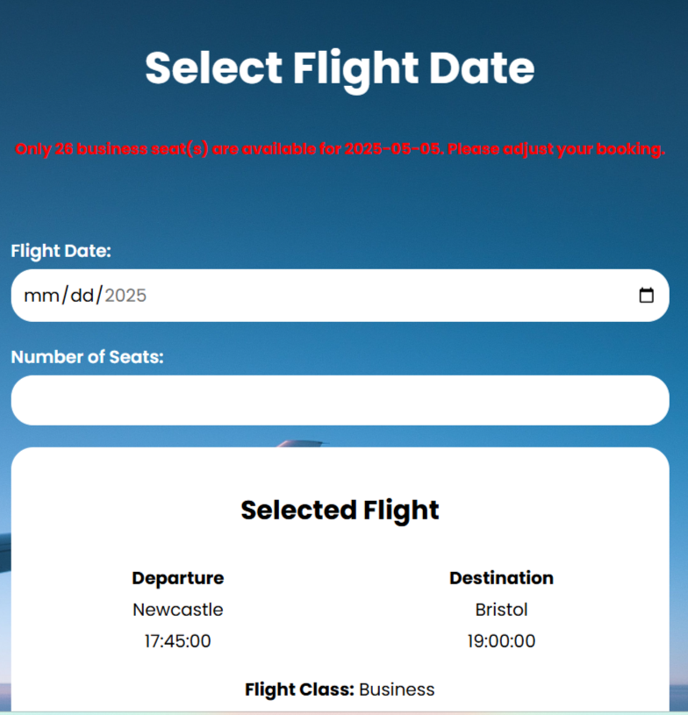
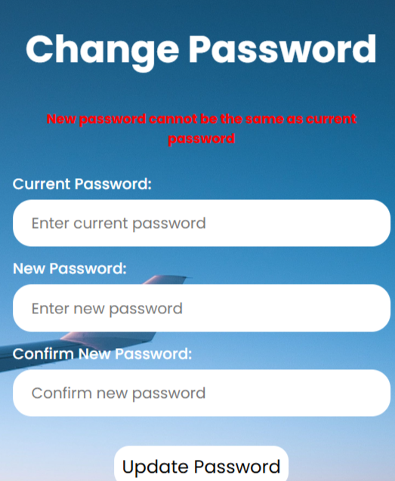
White Box Testing Examples (Cont’d)
9
10

Slide 18
White Box Testing ( Cont’d)
#Test | Subject | Description | Input | Expected Outcome | Actual Outcome
11 | Changing flight date after booking a ticket | Form handling for changing into a weekend date | Entering a weekend date to change booking | A red error text is displayed to notify the user that flights operate on weekdays only | Returns the same page and error pops up as expected
12 | Changing flight date after booking a ticket | Form handling for changing into a date where seats are fully booked | Entering a date where the flight for the chosen class is fully booked | A red error text is displayed to notify the user that the flight is fully booked on the selected date | Returns the same page and error pops up as expected

Slide 19
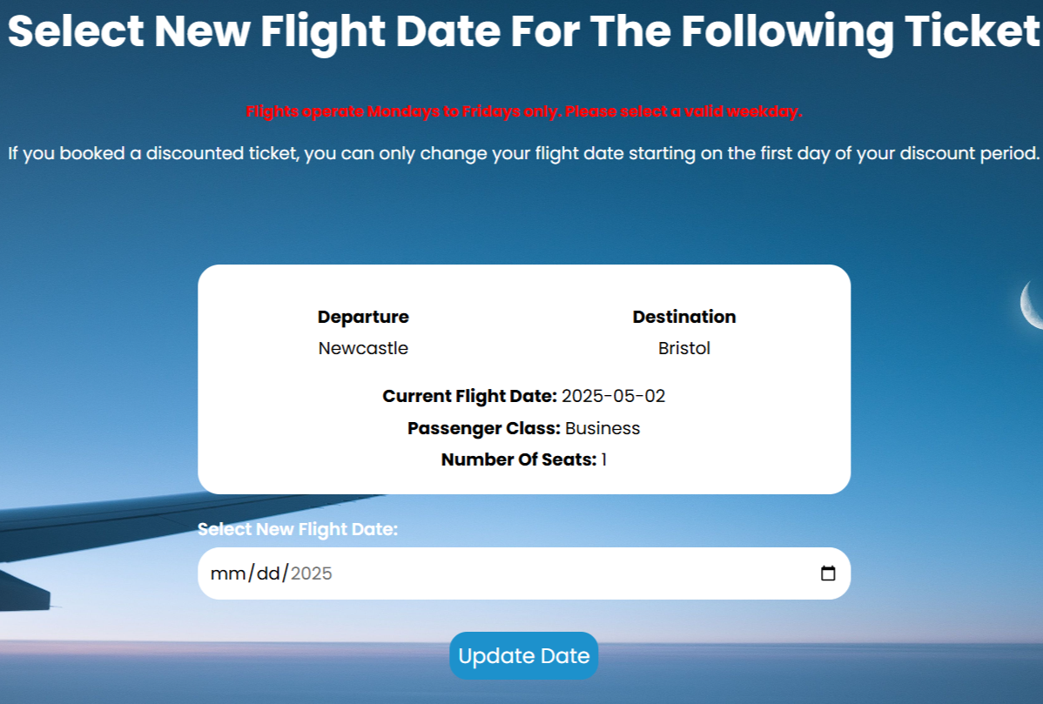
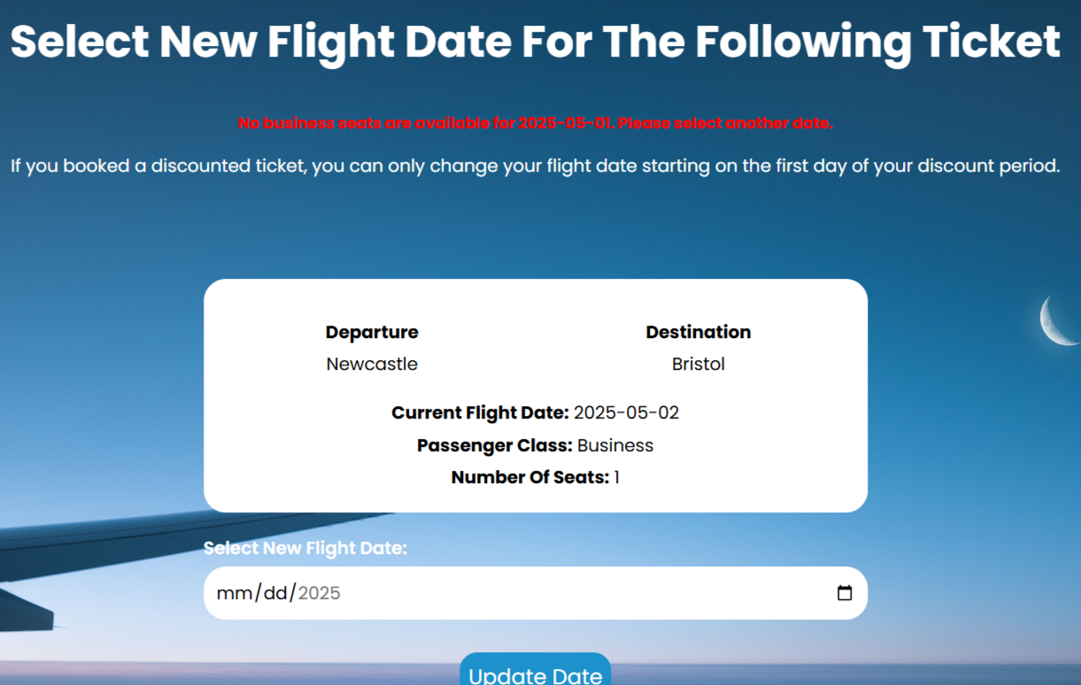
White Box Testing Examples (Cont’d)
11
12

Slide 20
White Box Testing (Cont’d)
#Test | Subject | Description | Input | Expected Outcome | Actual Outcome
13 | Changing flight date after booking a ticket | Form handling for changing into a date with more seats than available | Entering a date with more seats for the chosen class than availability | A red error text is displayed to notify the user that only a certain number of seats are available for the selected date | Returns the same page and error pops up as expected

Slide 21
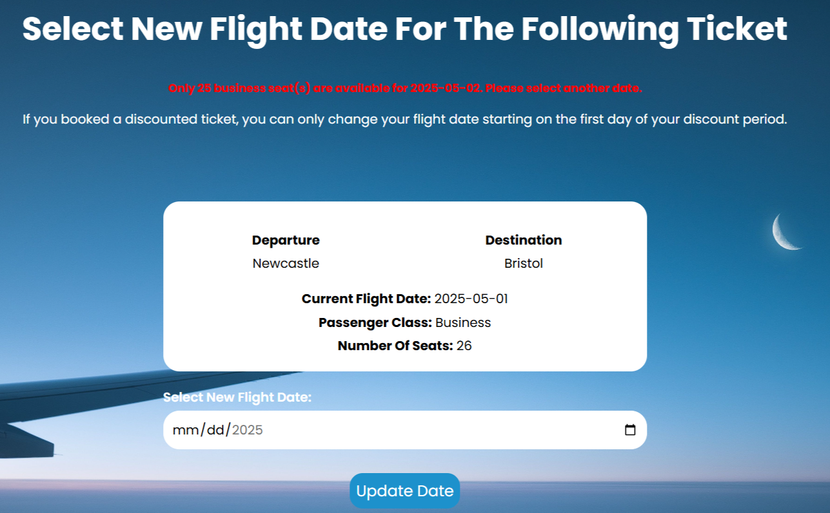
White Box Testing Examples (Cont’d)
13

Slide 22
Things I would add to improve my website
A password recovery system for users to easily and securely reset their passwords if they forget it.
An interactive seat map to enhance user experience during booking, similar to actual airline websites.
A payment mechanism that let users simulate paying directly with debit or credit cards.
A flight calendar during booking process to show which dates are available and which are fully booked for each flight.
A review section to allow users to leave a review in a five-star scale.
A mailbox for users to contact admins for customer support.
Additional reports for admins to view monthly sales, profits and losses.
A search box for admins to view ticket statuses by specifying reference numbers.

Slide 23
Self Evaluation
I believe my website meets all core business logic requirements from the brief including dynamic bookings, discounts, admin reports, and secure user management.
Data is dynamically retrieved and displayed throughout the website using Python Flask and Jinja templating expressions.
For data security, I implemented parameterised queries to prevent SQL injection attacks and securely stored user passwords by applying password hashing.
While I am pleased with the outcome, there are still areas I would like to improve, including the features highlighted in the previous slide. I would also like to spend more time for front-end development to create more visually appealing and responsive designs.

